Slide 1
Object Oriented Metrics

Slide 2
Object Oriented Metrics
Primary objectives for object-oriented metrics are no different than those for metrics derived for conventional software:
To better understand the quality of the product
To assess the effectiveness of the process
To improve the quality of work performed at a project level

Slide 3
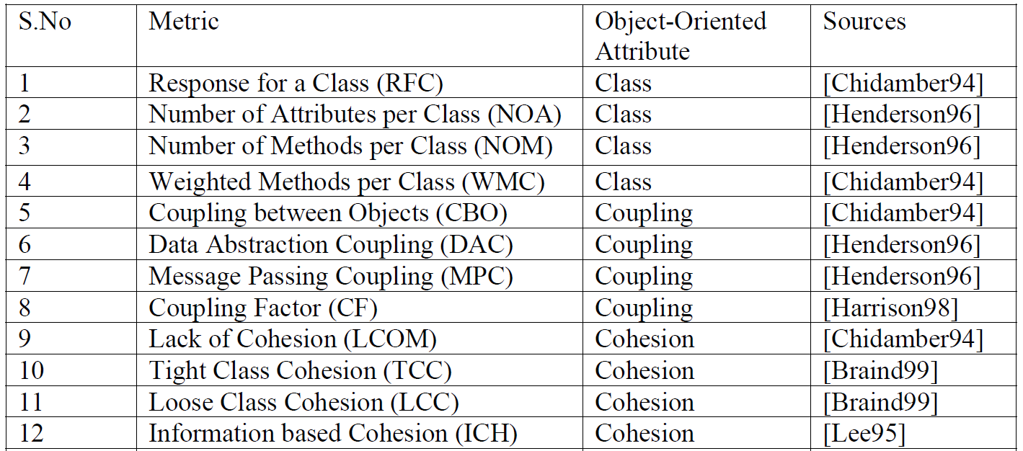
METRICS SET

Slide 4
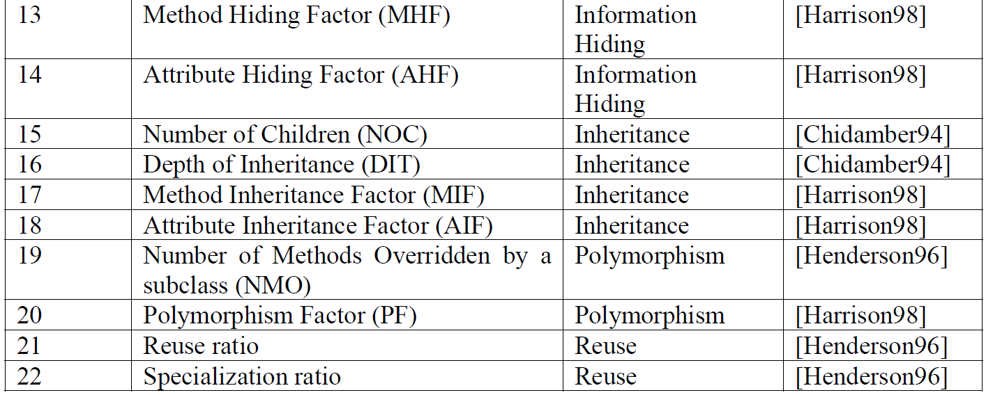
METRICS SET

Slide 5
METRICS DEFINITIONS AND APPLICATIONS
The metrics chosen for analysis can be divided into 7 categories viz.
size,
coupling,
cohesion,
inheritance,
information hiding,
polymorphism
reuse metrics.

Slide 6
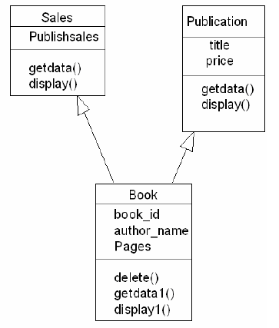

Size metrics
These measure size of the system in terms of attributes and methods included in the class and capture the complexity of the class.
Number of Attributes per Class (NOA)
Number of Attributes (NOA) for Publication class is 2. So NOA = 2 for Publication class.
Number Of Methods per Class (NOM)
Publication has two methods getdata( ) and display( ).
Hence NOM = 2 for Publication class
Weighted Methods per Class (WMC)
The WMC is a count of sum of complexities of all methods in a class
Assume that n methods of complexity c1, c2, . . ., cn are defined for a class C.
If all method complexities are considered to be unity, then WMC = n, the number of methods in the class
WMC for Book is 3

Slide 7

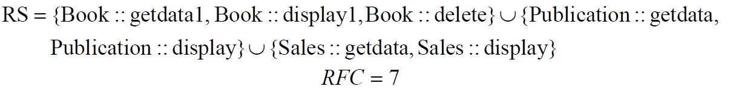
Size metrics
Response For a Class (RFC)
The response set of a class (RFC) is defined as set of methods that can be potentially executed in response to a message received by an object of that class. It is given by RFC=|RS|, where RS, the response set of the class, is given by

Slide 8
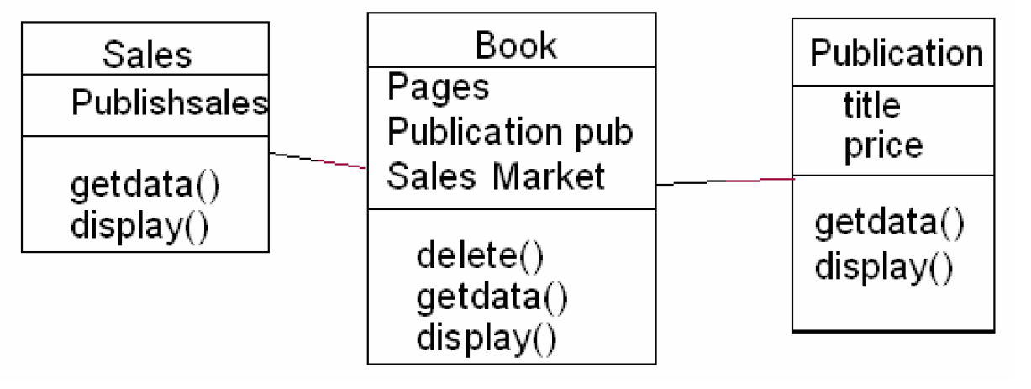
Coupling metrics
Coupling relations increase complexity, reduce encapsulation, potential reuse, and limit understanding and maintainability
Coupling Between Objects (CBO)
CBO for a class is count of the number of other classes to which it is coupled
Two classes are coupled when methods declared in one class use methods or instance variables defined by the other class.
The value of metric CBO for class Book is 2 and for class Publication and Sales is zero.
Message passing Coupling (MPC)
“number of send statements defined in a class”.
So if two different methods in class A access the same method in class B, then MPC = 2.
MPC value for class Book is 4 as methods in class Book calls Sales::getdata(), Sales::display(), Publication::getdata(),
Publication::display().

Slide 9
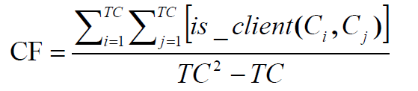
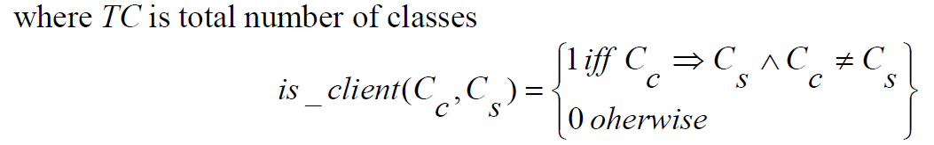
Coupling Factor (CF)
Coupling can be due to message passing (dynamic coupling) or due to semantic association links (static coupling) among class instances
It has been known that it is desirable that classes communicate with as few other classes and even when they
communicate, they exchange as little information as possible.
Couplings due to the use of the inheritance are not included in CF, because a class is heavily coupled to its ancestors via inheritance.
If no classes are coupled, CF = 0 % . If all classes are coupled with all other classes, CF = 100 %.

Slide 10
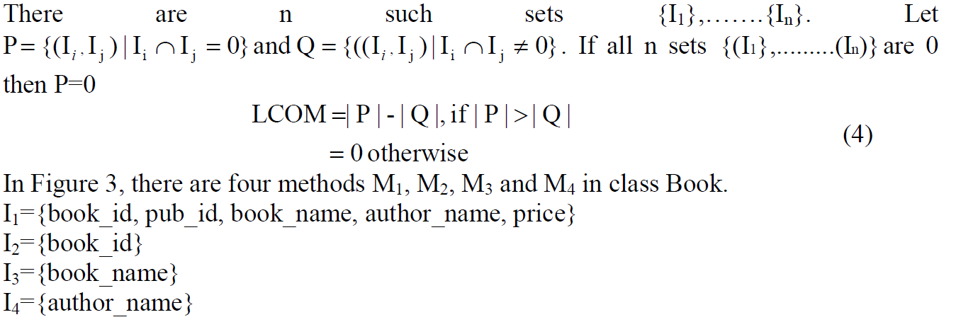
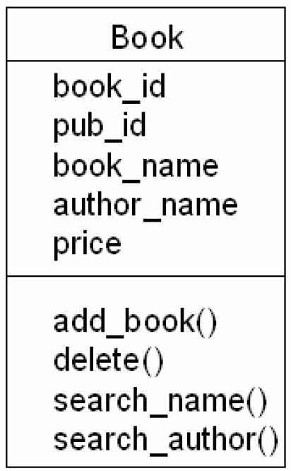
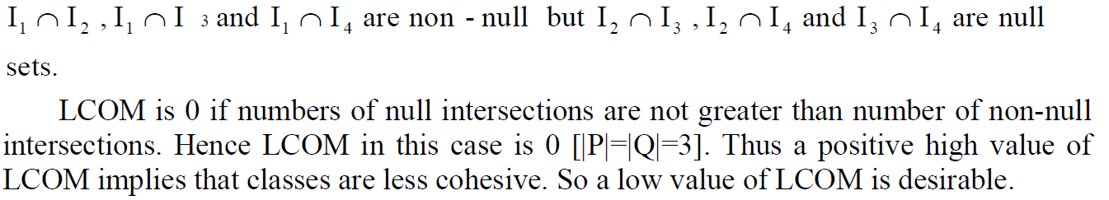
Cohesion Metrics
Cohesion is a measure of the degree to which the elements of a module are functionally related.
Lack of Cohesion in Methods (LCOM)
measures the dissimilarity of methods in a class by looking at the instance variable or attributes used by methods
Consider a class C1 with n methods M1, M2…., Mn. Let (Ij) = set of all instance variables used by method Mi.

Slide 11
CK metrics suite
CK has proposed six class-based design metrics for OO systems.
1. Weighted methods per class (WMC):-
Assume that n methods of complexity c₁, c₂, . . ., c_{n} are defined for a class C.
The specific complexity metric that is chosen (e.g., cyclomatic complexity) should be normalized so that nominal complexity for a method takes on a value of 1.0.
WMC = ∑ c_{i}
So if no. of methods are increase, complexity of class also increase.
Objects with large number of methods are likely to be more application specific, limiting the possible reuse

Slide 12
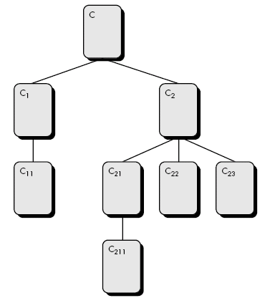
2. Depth of the inheritance tree (DIT):-
This metric is “the maximum length from the node to the root of the tree (base class)”
Referring to Figure, the value of DIT for the class-hierarchy shown is 4.
Lower level subclasses inherit a number of methods making behavior harder to predict
Deeper trees indicate greater design complexity
On the positive side, large DIT values imply
that many methods may be reused.

Slide 13
3. Number of children (NOC):-
The subclasses that are immediately subordinate to a class in the class hierarchy
Referring to previous figure, class C2 has three children—subclasses C21, C22, and C23.
As the NOC increases, reuse increases, but the abstraction represented by the parent class can be diluted.
Depth is generally better than breadth in class hierarchy, since it promotes reuse of methods through inheritance
Classes higher up in the hierarchy should have more sub-classes then those lower down
As NOC increases, the amount of testing (required to exercise each child in its operational context) will also increase.

Slide 14
4. Coupling between object classes (CBO):
CBO is the number of collaborations between two classes (fan-out of a class C)
The number of other classes that are referenced in the class C (a reference to another class, A, is a reference to a method or a data member of class A)
As collaboration increases reuse decreases
High fan-outs represent class coupling to other classes/objects and thus are undesirable
High fan-ins represent good object designs and high level of reuse
Not possible to maintain high fan-in and low fan outs across the entire system
As CBO increases, it is likely that the reusability of a class will decrease.
If values of CBO is high, then modification get complicated.
Therefore, CBO values for each class should be kept as low as is reasonable.
1. ‘FAN IN’ is simply a count of the number of other Components that can call, or
pass control, to Component A.
2. ‘FANOUT’ is the number of Components that are called by Component A.

Slide 15
5. Response for a class (RFC)
RFC is the “Number of Distinct Methods and Constructors invoked by a Class” (local + remote)
As RFC increases
testing effort increases
greater the complexity of the object
harder it is to understand

Slide 16
6. Lack of cohesion in methods (LCOM).
This is a notion of degree of similarity of Methods
LCOM is the number of methods that access one or more of the same attributes.
If no methods access the same attributes, then LCOM = 0.
If LCOM is high, methods may be coupled to one another via attributes. This increases the complexity of the class design.
In general, high values for LCOM imply that the class might be better designed by breaking it into two or more separate classes.
It is desirable to keep cohesion high; that is, keep LCOM low.

Slide 17
Take class C with M1, M2, M3
I1 = {a, b, c, d, e}
I2 = {a, b, e}
I3 = {x, y, z}
P = {(I1, I3), (I2, I3)}
Q = {(I1, I2)}
Thus LCOM = 1
There are n such sets I1 ,…, In
P = {(Ii, Ij) | (Ii ∩ Ij ) = ∅}
Q = {(Ii, Ij) | (Ii ∩ Ij ) ≠ ∅}
If all n sets Ii are ∅ then P = ∅
LCOM = |P| - |Q|, if |P| > |Q|
LCOM = 0 otherwise

Slide 18
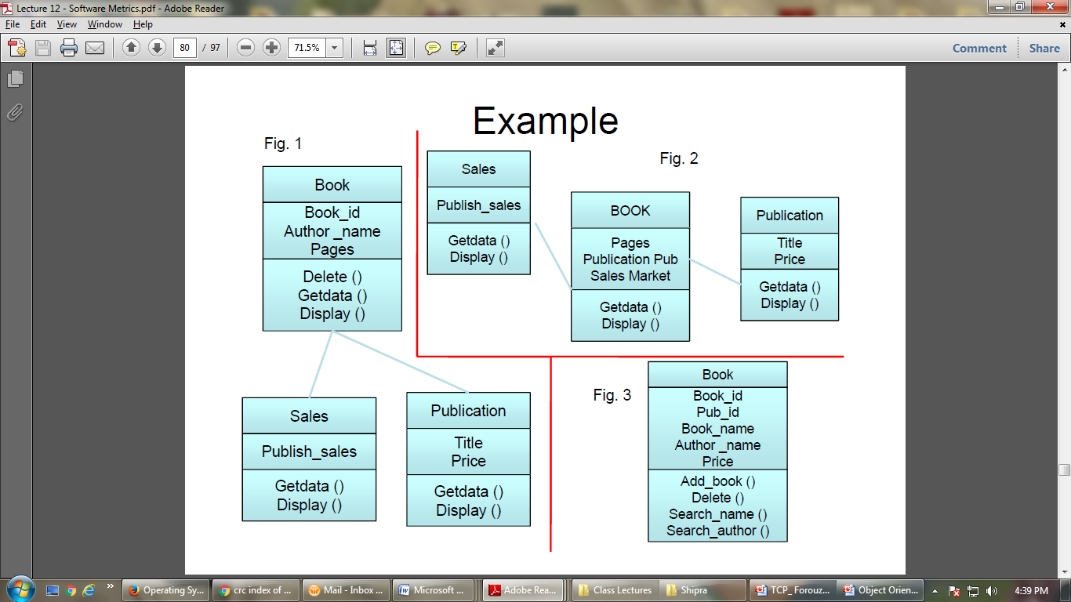
Example
Compute WMC, RFC, CBO, LCOM. Consider complexity to be 1

Slide 19
Solution
WMC for book is 3, sale is 2 and publication is 2
Weighted Number Methods in a Class (WMC)
Methods implemented within a class or the sum of the complexities of all methods
RFC = 3+2+2 = 7
Response for a Class (RFC )
Number of methods (internal and external) in a class.
CBO = 2 (class book) and 0 (class publication and sales)
Coupling between Objects (CBO)
Number of other classes to which it is coupled.

Slide 20
class A
{
psvm()
{
int a=10; int b=20;
book obj1=new book(a,b);
book obj2= new book(obj1);
}
}
class book
{
int a, b;
book (int a, int b)
{this.a=a;
this.b=b;
}
book(book ref)
{
a=ref.a;
b=ref.b;
}
obj1
obj2

Slide 21
LCOM: Lack of cohesion in methods
I₁ {add_book ( )} = { book_id, Pub_id, Book_name, Author_name, Price}
I₂ {delete ( )} = { book_id}
I₃ {search_name ( )} = {Book_name}
I₄ {search_author( )} = {Author_name}
I₁ ∩ I₂, I₁ ∩ I₃, I₁ ∩ I₄ are non null sets
I₂ ∩ I₃, I₂ ∩ I₄ and I₃ ∩ I₄ are null sets
Thus LCOM = 0, if no of null interactions are not greater than number of non null interactions. Hence, LCOM = 0 [| P| = |Q| =3]

Slide 22
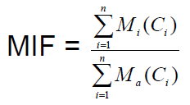
The MOOD Metrics Suite
1. Method inheritance factor (MIF).
The degree to which the class architecture of an OO system makes use of inheritance for both methods (operations) and attributes is defined
Value of MIF indicates impact of inheritance on the OO Software
M_{i}(C_{i}) is the number of methods inherited and not overridden in C_{i}
M_{a}(C_{i}) is the number of methods that can be invoked with C_{i}
M_{d}(C_{i}) is the number of methods declared in C_{i}
n is the total number of classes

Slide 23
M_{a}(C_{i}) = M_{d}(C_{i}) + M_{i}(C_{i})
All that can be invoked = new or
overloaded + things inherited
MIF is [0,1]
MIF near 1 means little specialization
MIF near 0 means large change

Slide 24
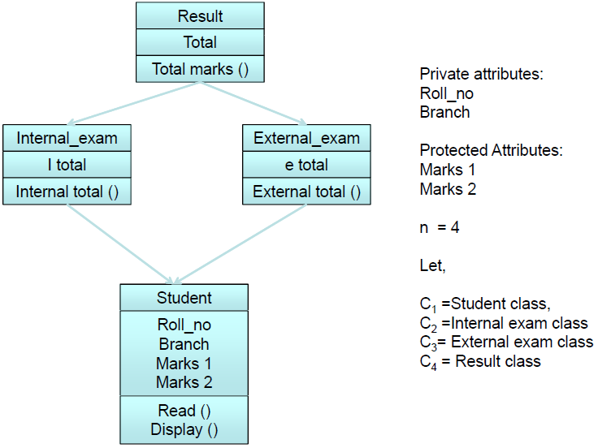
Example

Slide 25
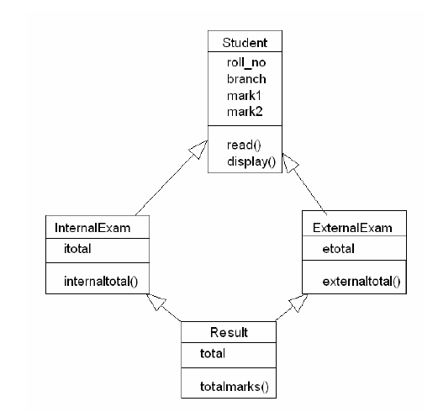

Slide 26
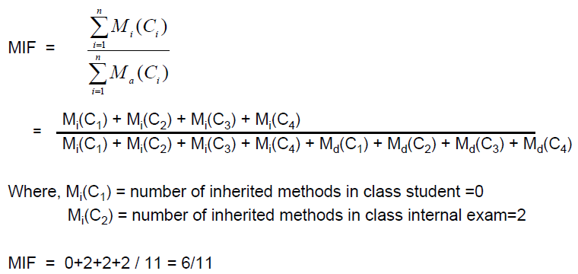
Solution

Slide 27
2. Coupling factor (CF) :
CF is defined as the ratio of the maximum possible number of couplings in the system to the actual number of couplings not imputable to inheritance.
CF = [∑_{i} ∑_{j} is_client (C_{i}, C_{j})]/(TC² - TC)
is_client = 1, if and only if a relationship exists between the client
class, Cc, and the server class, Cs, and Cc ≠ Cs
= 0, otherwise
(TC²-TC) is the total number of relationships possible, where TC= Total number of classes in the system under consideration.
CF is [0,1] with 1 meaning high coupling
As the value for CF increases,
the complexity of the OO software will also increase and
understandability, maintainability, and the potential for reuse may suffer as a result.

Slide 28
class A
{
B obj;
}
Class B{}

Slide 29
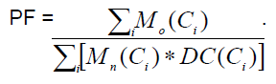
3. Polymorphism factor (PF).
PF as “the number of methods that redefine inherited methods, divided by the maximum number of possible distinct polymorphic situations
M_{n}() is the number of new methods
M_{o}() is the number of overriding methods
DC() number of descendent classes of a base class

Slide 30
4. Attribute Hiding Factor (AHF)
attribute hiding factor measure how variables and methods are encapsulated in a class.
An attribute is called visible if it can be accessed by another class or object. Attributes should be "hidden" within a class. They can be kept from being accessed by other objects by being declared a private.
AIF = (sum of the invisibilities of all attributes defined in all classes) / (total number of attributes defined in the project)
Ideally, all attributes should be hidden, and thus AHF=100% is the ideal value. Very low values of AHF should trigger attention.

Slide 31
5. Method Hiding Factor (MHF)
The Method Hiding Factor measures the invisibilities of methods in classes.
An attribute is called visible if it can be accessed by another class or object. Attributes should be "hidden" within a class. They can be kept from being accessed by other objects by being declared a private.
AIF = (the sum of the invisibilities of all methods defined in all classes.) / (total number of methods defined in the project)
Ideally, The Method Hiding Factor should have a large value.

Slide 32

6. Attribute inheritance factor (AIF)

